Slide 1
A型(策略型)與B型(操作型)知識管理
我們知道我們所知道的(We know what we know )
知識的形成
我們知道我們所不知道的(We know what we don't know)
結構化
未結構化
知
道
不
知
道
B型知識
A型知識
知
識
的
分
享
"I know that I know nothing" is a well-known saying which is attributed to the Greek philosopher Socrates. The preferred saying, as recorded in much literature, is "The only real wisdom is knowing you know nothing"
藉由教育訓練
落實執行方案
藉由功能團隊
發展執行方案
藉由制度規範
以回復技能
藉由多元群組創新
互動以超越舊框架
B’型知識
A’型知識
我們不知道我們所知道的(We don't know that we know ) 。
我們不知道我們所不知道的(We don't know what we don't know )。(但卻是應該知道的。)

Slide 2
A型(策略型)與B型(操作型)知識管理
We know what we know (good, because we are aware and confident).
We don't know that we know (bad, because we lack awareness and confidence).
We know what we don't know (good, because we are humble and motivated).
We don't know what we don't know (bad, because we are ignorant and vulnerable).
以上引自http://en.wikipedia.org/wiki/Talk:There_are_known_knowns

Slide 3
A型與B型知識管理：學習與反思觀
知識的形成
我們知道我們所知道的
我們知道我們所不知道的
結構化
未結構化
知
道
不
知
道
B型知識
A型知識
知
識
的
分
享
功能反思
操作反思
概
念
反
思
B’型知識
A’型知識
我們不知道我們所知道的
我們不知道我們所不知道的

Slide 4
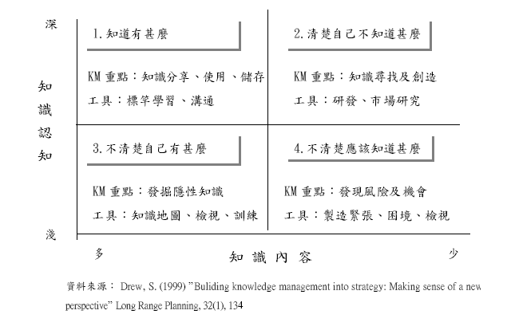
Knowledge Portfolio
http://www.sciencedirect.com/science/article/pii/S0024630198001423

Slide 5
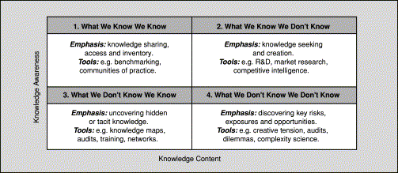
Stephen Drew的知識組合模型
From a strategy perspective perhaps the type of knowledge that poses the greatest threats and opportunities is type 4: what we dont know we dont know. This might include the emergence of unsuspected new technologies, substitute products and new competitors. In the terms of complexity theory this is where the butterfly effect may most often be found—where small and apparently insignificant events lead to momentous impacts.
http://www.sciencedirect.com/science/article/pii/S0024630198001423

Slide 6

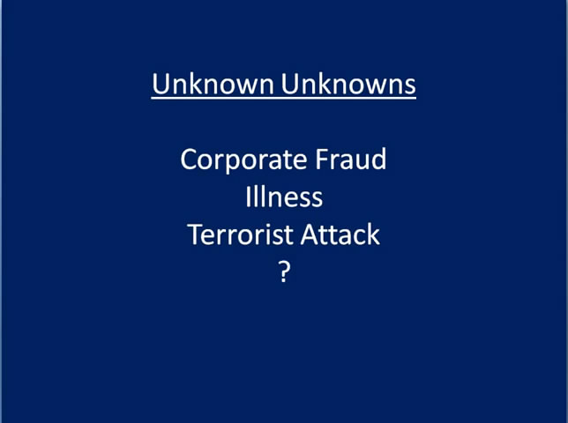
Unknown Unknowns

